Slide 1
Unsupervised Machine Learning
Creating playlists on Moosic:
an analysis involving music, data and machine learning
Notes:
First of all, the good news: both are right...in their own way...isn't that great?

Slide 2
Critical questions of the project
Are the given audio features able to identify “similar songs”, as defined by humanly detectable criteria?
Is K-Means a good method to create playlists? Would you stick with this algorithm moving forward, or explore other methods to create playlists?

Slide 3
Data preparation
Features dropped:
Nan
Type
Audio perspective
Key - Mode - Tempo - Duration_ms -Time_signature
Variance and Correlation
Speechiness - Loudness
Features used:
Danceability
Energy
Acousticness
Instrumentalness
Liveness
Valence

Slide 4
Modelling using the K-Means
We decided in regards to the features which are left that there is no need to scale because all values have been already in the range of 0 and 1.
2 methods to calculate the number of clusters:
Elbow method
Silhouette coefficient

Slide 5
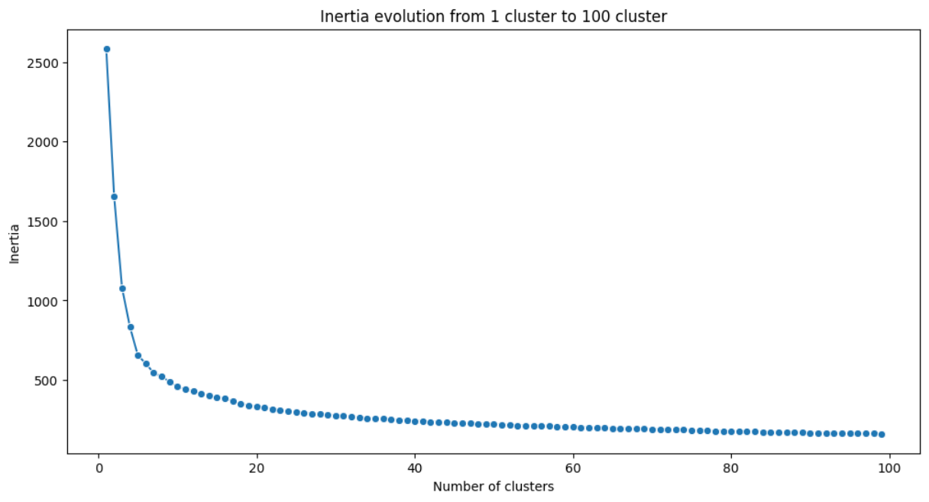
Modelling - The Elbow method
This the elbow from cluster 1 to 100. It seems that clustering with 6 clusters seems quite good.
But the condition which was set by moosic has been creating a playlist out of a dataset of 5000 songs with a minimum of 50 songs to 250 songs maximum.

Slide 6
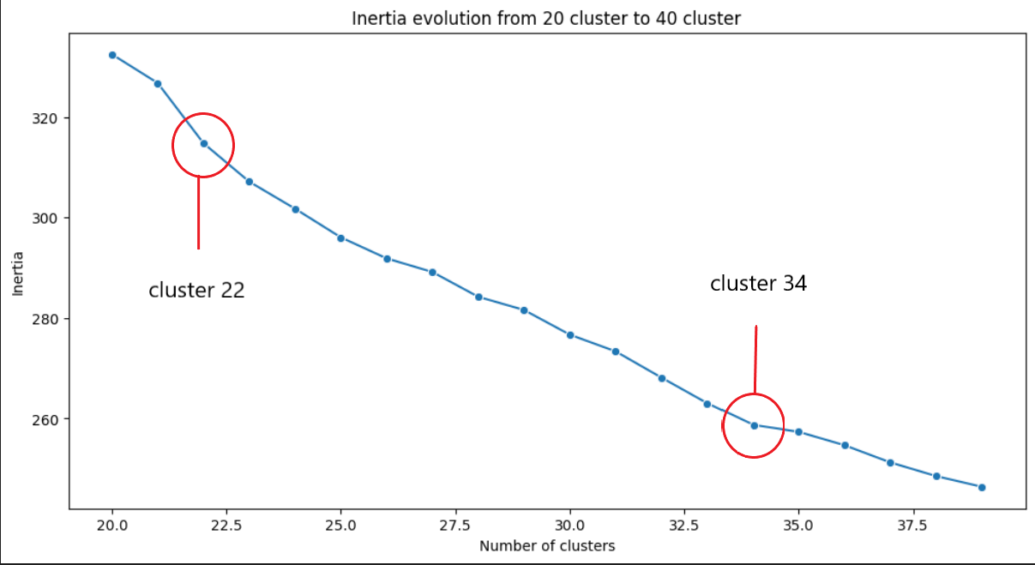
Modelling - The Elbow method
So we took 20 to 100 clusters in consideration.
This the elbow from cluster 20 to 40.
It seems that clustering with 22 or 34 clusters seems quite good.

Slide 7
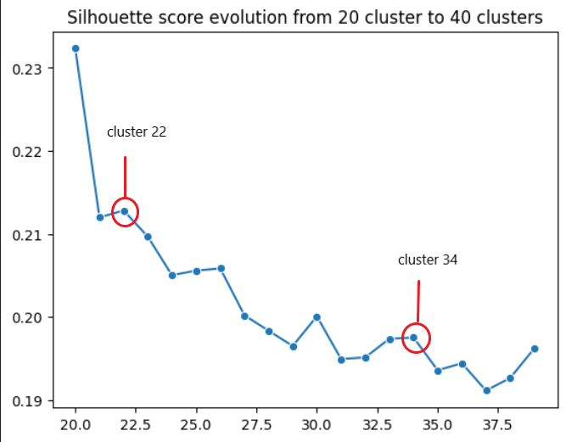
Modelling - The Silhouette Coefficient
Comparing the clusters we got from the elbow method (20 to 40 clusters) with the same amount of clusters but using the silhouette coefficient shows that 22 or 34 clusters seem to work as well.

Slide 8
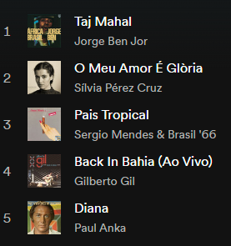
The final model after implementing into the Spotify playlist (5 samples using 22 clusters)
WORLD MUSIC
Everything fine?
Well…

Slide 9
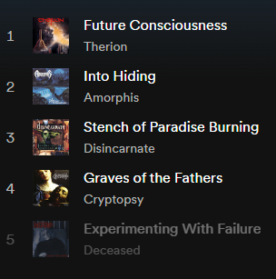
The final model after implementing into the Spotify playlist (5 samples using 22 clusters)
METAL: Looking at the playlist and the subgenres in detail:
Therion has been playing Death Metal but is nowadays Symphonic Metal (Sweden)
Amorphis is Death Metal (Finnland)
Disincarnate is Death Metal (USA)
Cryptopsy is Technical Death Metal/Metalcore (Canada)
Deceased has been Death metal but is now Thrash Metal/Heavy Metal (USA)

Slide 10
Conclusions
K-means is a good way to categorize unlabeled data as shown in our findings but it could be implemented better:
Optimize Cluster Size for Precision: Using a smaller number of clusters can enhance the precision of cluster definitions.
Incorporate Rich Listener Preferences: Enhance clustering accuracy by including features related to listener preferences, such as genres, subgenres, time periods, analysis of lyrics and country of origin.
Leverage Hybrid Clustering Approaches: Combining K-means with techniques like Hierarchical Clustering or DBSCAN can yield finer results.

Slide 11
Questions?
Thank you for your attention. We are now ready to answer any questions you may have.
The Moosic Machine Learning Team:
Gustavo
Saddam
Mirella

Slide 12
Appendix

Slide 13
deus ex machina?
a guide on (magical) machine learning
Steps:
Data preparation: (2 slides max)
Reading the data
Initial quick exploration
Dropping unwanted features
Modelling: (2 slides max)
Data scaling (potentially, other transformations)
K-Means exploration of clusters (elbow method, silhouette coefficient…)
K-Means final model
Cluster exploration: (2 slides max)
Univariate and bivariate exploration of the clusters
Manual labelling of the clusters
Notes:
First of all, the good news: both are right...in their own way...isn't that great?

Slide 14
Data preparation - drop unwanted features?
The sound engineer's point of view:
key doesn't matter because people don't have that much interest on listening a song with a specific key
loudness people can turn up the volume themselves , goes also along with energy and the correlation between the energy and loudness is high
mode there are only 2 values (0 and 1) and almost 70% of the data got the value of 1 so this will lead to a biased prediction and this feature is also represented in variance with a better range
speechiness the variance is too small compared to the others features
tempo is found more detailed in energy and valence
type dataset contains no values
time_signature more than 80% of the songs have 4/4 and it is not that important to listeners
duration is as well not on the focus of listeners

Slide 15
Data preparation
16 given features
Danceability
Energy
Key
Loudness
Mode
Speechiness
Acousticness
Instrumentalness
Liveness
Valence
Tempo
Type
Duration_ms
Time_signature
Id
html

Slide 16
Conclusions
Is K-Means a good method to create playlists?
K- means can be used when you have unlabeled data (data without defined categories or groups)
It finds groups in the data, with the number of groups represented by the variable K.
There are two challenges that need to handled wisely in order to get the most out of the k-means clustering algorithm:
Clusters in the data set must be approximately equal in size (the algorithm always partitions the data set at the midpoint between the cluster centers)
Data set must not contain much noise or many outliers
Defining the number of clusters
Determining the initial centroids.
The simplest approach is to run the algorithm several times in a row with different starting values and take the best solution - which costs time and resources. Another disadvantage is that the number of cluster centers chosen in advance. Using an unsuitable may result in completely different, possibly unintuitive solutions. With a "wrong" k, no good clustering can take place. The solution is to try different values for k and then choose a suitable one, for example using the elbow method and the silhouette coefficient at the same time.
Somehow classify the music not involving genres, features like energy and valence and instrumental are defining the playlists.
The period of time in which the music has been released could have a great impact as well but it wasn’t given as a feature.
Another methods would be hierarchical DBSCAN

